Slide 1
Project Presentation Of FULL STACK ENGINEERING (FSE)
on
ESTATE EDGE
Arpita Rana 2210991359
Arshika 2210991369
Gunjan 2210991588
Department of Computer Science and Engineering,
Chitkara University, Punjab

Slide 2
ESTATE EDGE
Welcome to ESTATE EDGE, your trusted destination for buying, selling, and renting properties! Whether you're looking to find your dream home, rent a cozy apartment, or sell your current property, we make the process easy and hassle-free. With a wide range of listings, expert guidance, and personalized service, we ensure a smooth real estate experience for every need.
Our platform offers advanced search filters, real-time updates, verified listings, and secure communication to help you make informed decisions. We also prioritize transparency, offering authentic reviews and seamless interaction between property owners and tenants.
Explore our platform today, and take the first step towards your property goals with confidence. Whether you're buying, selling, or renting, ESTATE EDGE is here to make your real estate journey simpler, faster, and more efficient!
2

Slide 3
ABOUT US
Estate Edge – your trusted partner in real estate. At Estate Edge, we believe in making property transactions simple, transparent, and stress-free. Whether you're looking to buy, sell, or rent, our goal is to provide you with an exceptional experience every step of the way. Founded with a passion for real estate and a commitment to customer satisfaction, Estate Edge brings together a team of experienced professionals dedicated to helping you achieve your property goals.
Our extensive network of listings, in-depth market knowledge, and personalized approach ensure that you find the right property or make a successful sale, whether you're a first-time buyer, seasoned investor, or a homeowner looking to rent
3

Slide 4
PROBLEM STATEMENT
In the rapidly evolving real estate market, the process of finding and renting flats has become increasingly cumbersome, especially for property owners and potential tenants. The traditional methods of advertising properties, such as offline listings (newspapers, posters, etc.) or fragmented online platforms, often present significant inefficiencies, lack transparency, and involve high intermediary costs. These problems persist, making it difficult for both property owners and tenants to navigate the real estate landscape effectively.
Several key challenges exacerbate the inefficiency of the current rental system:
Limited Accessibility: Property owners often struggle to reach a broad audience of potential renters. Offline methods, like word-of-mouth or local ads, limit the number of people who can see the listing, and even online platforms fail to maximize reach due to their fragmented nature. As a result, owners miss out on potential tenants, and tenants waste time browsing through multiple, disconnected platforms.
Inefficient Communication: Tenants frequently encounter difficulties when trying to contact property owners directly. They may have to deal with third-party agents or unclear channels of communication. Furthermore, verifying property details can be time-consuming, as listings may be outdated, inaccurate, or lack detailed descriptions, making it harder for tenants to make informed decisions.
Fragmented Processes: The absence of a unified platform creates an inefficient experience for both parties. Information about available properties is scattered across various platforms, such as real estate websites, classifieds, and social media. This fragmentation forces users to juggle multiple sources of information, which is often disorganized and incomplete.
4

Slide 5
WHY CHOOSE US?
Expert Guidance: Our team of real estate professionals is here to guide you through the buying, selling, and renting processes with knowledge and expertise.
Wide Selection of Properties: From homes and apartments to commercial spaces, we offer a diverse range of properties that suit every need and budget.
Customer-Focused Service: Your satisfaction is our priority. We provide personalized services that cater to your specific real estate goals.
Transparent Process: We believe in clear communication and transparency, making your real estate journey smooth and worry-free. At Estate Edge, we’re not just about transactions; we’re about building lasting relationships with our clients. Trust us to be by your side in every real estate decision, big or small.
5

Slide 6
OUR SERVICES
SELL HOUSE: We make selling your home a smooth and efficient process. Our experts help you set the right price, market your property effectively, and negotiate the best deal. Trust us to handle every detail so you can focus on your next chapter.
BUY HOUSE: Finding your perfect home has never been easier. Our extensive listings and market knowledge ensure you have access to the best properties available. We guide you through the entire buying process, from viewing homes to securing the best deal.
RENT HOUSE:Whether you're looking for a short-term rental or a long-term place to call home, we offer a wide range of rental properties to suit your needs. Our team will help you find a property that fits your lifestyle and budget, making the rental process simple and hassle-free.
6

Slide 7
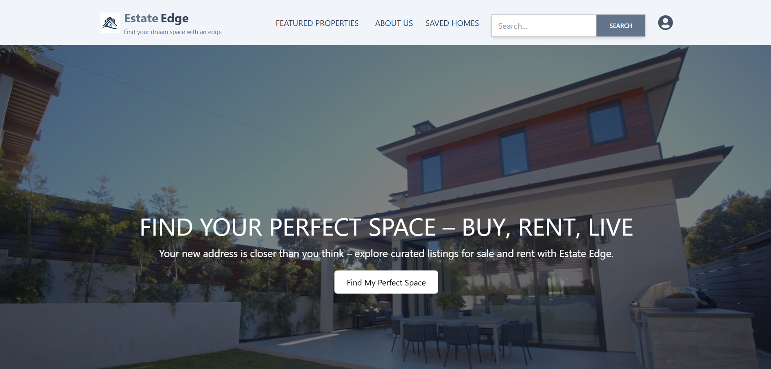
Project Snapshots:

Slide 8
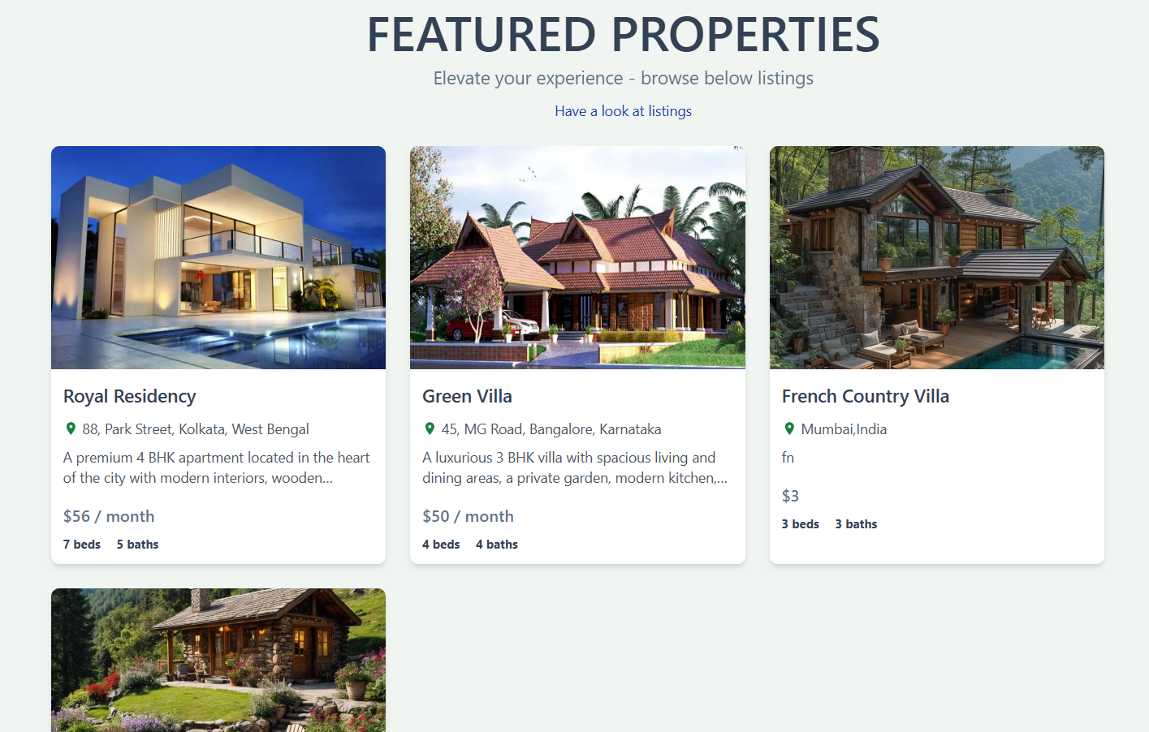

Slide 9
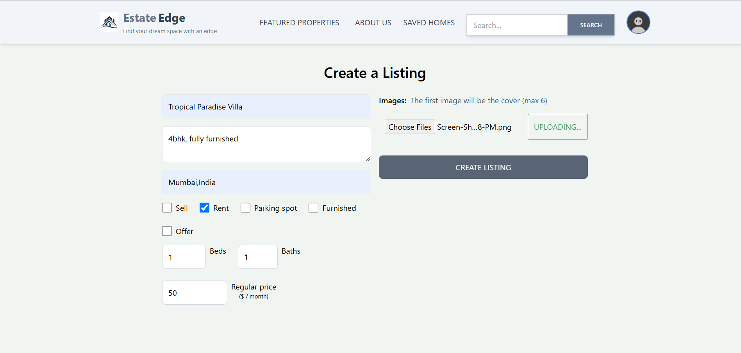

Slide 10
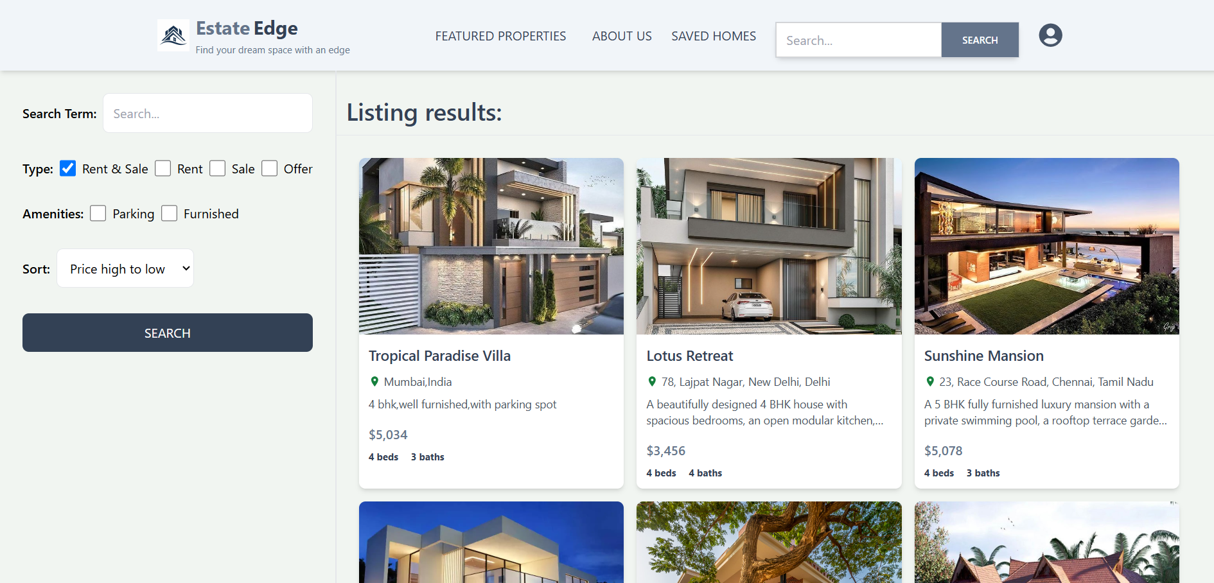

Slide 11
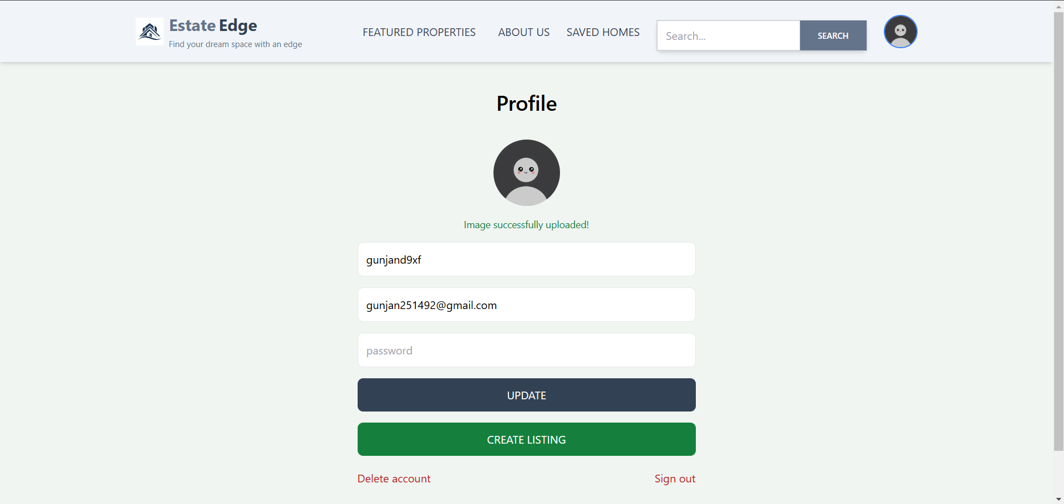

Slide 12
TECHNOLOGIES AND TOOLS
7.1 Methods
Express.js-Express.js is the web application framework for Node.js. It simplifies the creation of routing and handling HTTP requests, providing middleware for handling various tasks such as user authentication, data validation, and logging. Express’s flexibility and minimalism make it ideal for building APIs and server-side logic for Estate Edge.
MongoDB-MongoDB, a NoSQL database, is used to store various types of unstructured data, such as user details, property listings, reviews, and more. Its flexible schema design allows for easy scaling and efficient querying, which is particularly useful as the platform grows. MongoDB’s document-based model also makes it a great choice for handling diverse types of data, such as property descriptions, images, and user reviews.
Mongoose-Mongoose is an ODM (Object Data Modeling) library for MongoDB, providing a higher-level abstraction for working with data. It simplifies database operations, such as creating, querying, and updating documents. Mongoose also enforces schema validation, ensuring that data remains consistent and secure.
JSON Web Tokens (JWT)-JWT is used for securing the platform by providing a token-based authentication system. JWT enables secure communication between the frontend and backend by transmitting user credentials securely. It ensures that only authenticated users can access certain features of the platform, such as listing properties or messaging potential tenants. JWT tokens are issued after a successful login and are used for validating subsequent requests.

Slide 13
FUTURE SCOPE
The future of Estate Edge holds immense potential for innovation and expansion. By integrating advanced AI technologies, the platform can offer personalized property recommendations, ensuring a tailored experience for users. Virtual and augmented reality (AR/VR) can revolutionize the way tenants explore properties, allowing immersive virtual tours from the comfort of their homes. As the platform grows, global expansion can be achieved by implementing multi-language support and localized features, catering to diverse audiences worldwide. Blockchain technology could enhance security and transparency in rental transactions, fostering trust between property owners and tenants.
Blockchain technology could enhance security and transparency in rental transactions, fostering trust between property owners and tenants. Developing a dedicated mobile application for iOS and Android will further improve accessibility, enabling users to engage with the platform on the go. Additionally, the platform can embrace sustainability by promoting eco-friendly properties and integrating features that align with environmentally conscious practices. These future advancements will position Estate Edge as a pioneering solution in the rental property market, ensuring it remains competitive and continues to adapt to evolving user needs and technological trend.

Slide 14
CONCLUSION
The Estate Edge project is designed to revolutionize the rental property marketplace by creating an intuitive, user-friendly platform that connects property owners and tenants directly. By leveraging the power of modern web technologies, the project focuses on:
Enhanced User Experience:
A responsive design ensuring seamless access across all devices.
Improved Transparency:
Verified listings and user reviews to foster trust.
Secure Platform:
Robust authentication and encryption to ensure data protection.
Efficient Property Management:
Real-time updates on listings, inquiries, and user interactions.
Scalability and Performance:
Built to handle increasing traffic and data demands effectively.
By addressing these objectives, Estate Edge aims to streamline the rental property market, offering a reliable and efficient solution for all stakeholders.

Slide 15
BIBLIOGRAPHY/REFERENCES
MongoDB Documentation. "NoSQL Database for Modern Applications." MongoDB, 2024. https://www.mongodb.com
React.js Official Documentation. "A JavaScript Library for Building User Interfaces." Meta, 2024. https://reactjs.org
Node.js Documentation. "JavaScript Runtime Built on Chrome's V8 JavaScript Engine." OpenJS Foundation, 2024. https://nodejs.org
Twilio API Documentation. "Cloud Communications Platform." Twilio, 2024. https://www.twilio.com/docs
SendGrid API Documentation. "Email Delivery Service." SendGrid, 2024. https://sendgrid.com/docs

Slide 16
Thank You
16

